Slide 1
Fuel Types-continued
NE 591

Slide 2
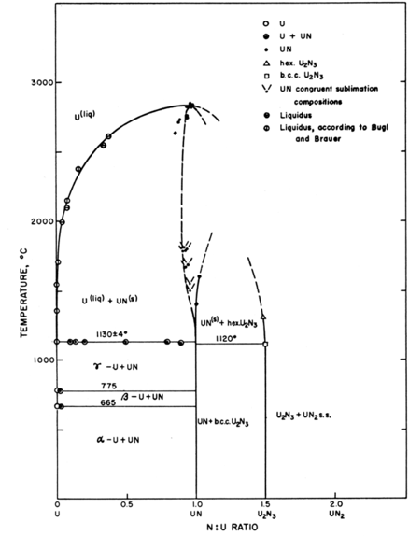
UN – Lead Cooled Reactors
Can appear as UN, U₂N₃, or UN₂
Advantages
High thermal conductivity
High fuel density
Thermally stable
High melting temperature
Disadvantages
Corrodes in water
Reacts with some cladding
Difficult to manufacture
Requires N-enrichment

Slide 3
Unique Fuel Designs
Lightbridge
High Zr content UZr alloy
Cruciform geometry fuel rods, combined into fuel elements
Kairos
TRISO particle compacts with low density core
Float in molten salt coolant for online refueling

Slide 4
Unique Fuel Designs
NASA/LANL
UMo fuel for space reactors: KRUSTY
Stable Salt Reactor (SSR)
Dissolved molten salt fuel
NaCl-U-Pu-stuff

Slide 5
Fuel Summary Table
Property | UZr | UO₂ | UC | UN | U₃Si₂
Corrosion resistance in water | Very poor | Excellent | Very poor | Poor | Poor
Compatibility with clad materials | Reacts with normal clad | Excellent | Variable | Variable | Variable
Thermal stability | Phase change at 665 and 770 °C | Good | Good | Good | Good
Uranium (metal) density (g/cm³) | 19.04 | 9.65 | 12.97 | 13.52 | 11.31
Melting point (°C) | 1132 | 2865 | 2850 | 2860 | 1665
Thermal conductivity (W/m-K) | 38 at 430 °C | 3 at 1000°C | 25 at 500°C | 20 at 750°C | 23 at 773°C

Slide 6

Fuel Types Summary
There exist a number of nuclear fuels in different stages of utilization and development
Each reactor design or application has individual needs, and no one fuel is one size fits all
Need to balance safety, performance (normal, off-normal, extended), manufacturability, processing, waste, etc.

Slide 7
Questions/Comments/Summary
Primary purpose of fuel is heat source
Uranium is most viable candidate for nuclear fuel materials
Uranium is combined with O, C, N, transition metals for a variety of fuel types
UO2: ceramic, commercial reactor fuel, light water reactors
ATF: U3Si2 and Cr-doped UO2
UZr: fast reactor fuel
UMo: research reactor fuel
UC/UCO: high temperature gas reactors

Slide 8
Fission and heat generation
NE-591

Slide 9
Fission basics
Impinging neutron of a given energy
Neutron energy determines cross section which determines probability of fission event
Neutron + Target Nucleus -> Two fission products, 2-3 neutrons
Fission releases around 210 MeV of energy
170 MeV to fission fragments
2 MeV per neutron
7 MeV gamma rays
Balance radioactive decay

Slide 10
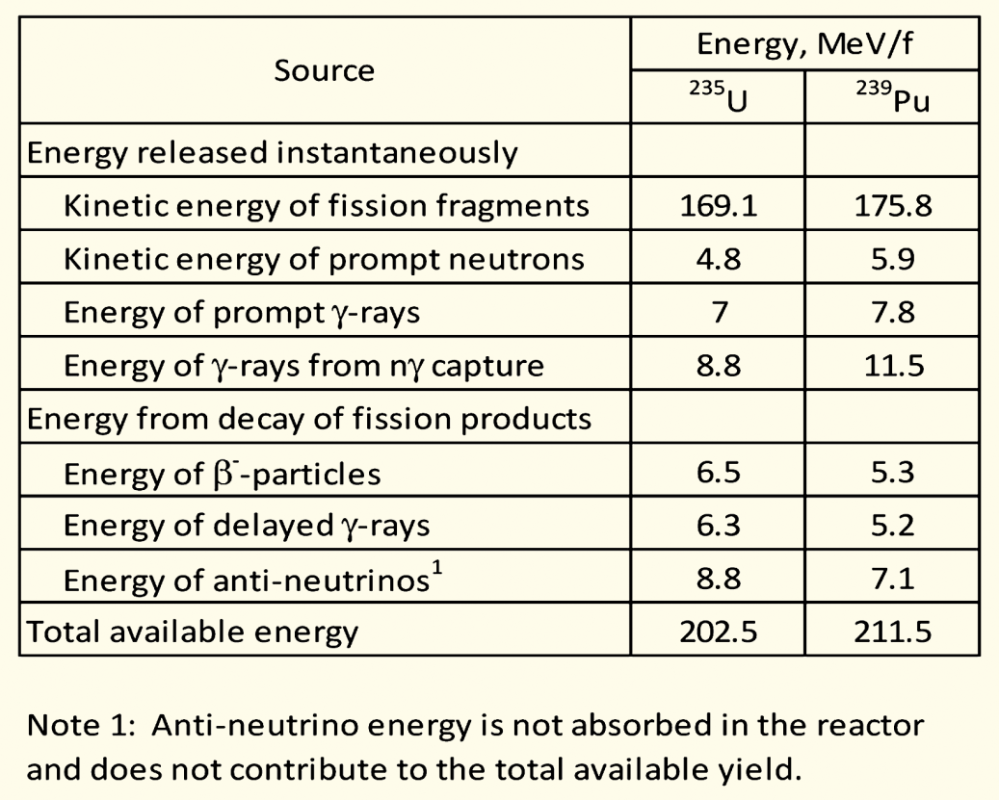
Energy release with different nuclei
Energy release is effectively agnostic with regards to the fissioning species
Comparing U-235 with Pu-239 on the right

Slide 11
Fission product yield
Regardless of fissioning isotope, fission product yields are effectively the same, in this double hump distribution
One broad peak centered around A=95, the other around A=135
Examples:
Mo (Z=42, A=96)
Cs (Z=55, A=133)

Slide 12
Fission Product Yields

Slide 13
Calculating heat generation rate for a given fuel
We know about 200 MeV of energy is available due to a fission (210 MeV minus neutrinos)
We know the fission cross section of the target nuclide (tabulated)
We can calculate the fission atom density
The heat generation rate, Q is given by:
Q = E_{f} x N_{f} x σ_{f} x φ
Where E_{f} is the fission energy, N_{f} is the fission atom density, σ_{f} is the fission cross section, and φ is the neutron flux
Units: J/fission x atoms/cm³ x (fission/neutron)*(cm²/atom) x (neutron/cm²-s) = J/cm³-s

Slide 14
Calculating heat generation rate for a given fuel
Cross sections:
ENDF database: Nuclear Data Sheets 148 (2018) 1–142
Thermal neutron (E=0.025 eV) U235 fission cross section: 586.8 barns
1 barn = 10⁻²⁴ cm²
Fission atom density
Atom density of U-235 = UO2 density x 1/molar mass x Avogadros number x atom fraction x enrichment

Slide 15
Calculating heat generation rate for a given fuel
Given a density of UO2 (10.97 g/cm³)
Enrichment of 3%
Molar mass of 3% enriched UO2
235*0.03 + 238*0.97 + 2*16 = 269.9 g/mol
Atom density of U-235 = 10.97 x 1/269.9 x 6.022E23 x 1/1 x 0.03
2.45E20 atoms/cm³
Given a flux of 5E13 neutrons/cm²/s
Q = E_{f} x N_{f} x σ_{f} x φ
200E6 eV x 1.602E-19 J/eV x 2.45E20 atoms/cc x 587E-24 cm² x 5E13 n/cm²/s
Q = 230 J/s/cm³ = 230 W/cm³

Slide 16
Some notes
Fast neutron cross section ~100x less than thermal neutron cross section
Fuels for fast neutron spectrum typically have high enrichments, 19.7% U-235
Historical research reactor fuels, such as UMo and U3Si2, have had an enrichment of 90+%
Neutron flux will vary depending on the reactor
HFIR has a peak neutron flux of 3E15 n/cm²/s
PULSTAR has a peak neutron flux of 1E13 n/cm²/s
Significant variability in heat generation depending on fuel type and reactor conditions

Slide 17
Reactor Systems
NE 591

Slide 18
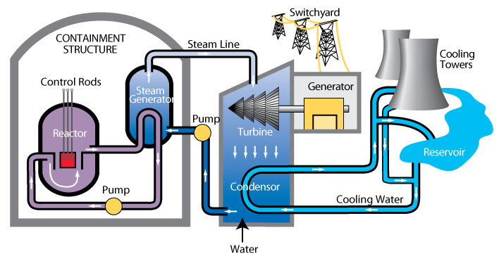
Heat removal systems
Last time, worked though the heat generation rate in the fuel
Now we touch on how heat is removed from the fuel
Primary mechanism to remove heat directly from fuel is a coolant
Various coolant types, most common is water

Slide 19
Heat removal systems
Primary loop water runs through the core, transporting heat generated by the fuel, to a steam generator in a secondary water loop
Steam drives a turbine, generating electricity
A tertiary water loop helps to condense residual steam from the secondary loop via cooling towers and a water reservoir

Slide 20
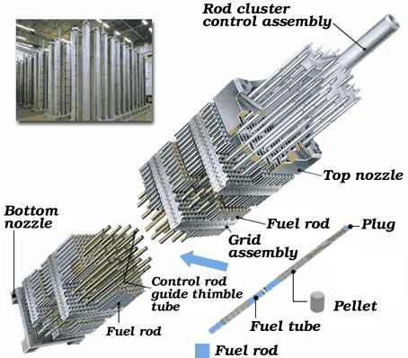
Light Water Reactor Core Design
An LWR core is comprised of fuel assemblies
Each assembly contains a grid of fuel pins
In typical commercial LWR fuel designs, a 17x17 grid
Some pins are replaced by control rods
Water flows from bottom to top

Slide 21
LWR Fuel Pins
LWR fuel pins are comprised of a hollow Zircaloy tube
This is the cladding
Zircaloy is a type of Zr alloy
Inside the cladding are stacked UO2 pellets
Each pellet is a cylinder about 1 cm in diameter and 1 cm in height

Slide 22
Not only water cooled reactor designs

Slide 23
Not all fuel is pellet-based
Metallic fuel is a solid fuel slug
Utilized an Fe-based cladding, such as HT-9 or SS
TRISO particles are formed into spherical compacts, or can be formed into pellet compacts
UMo and USi have been used in plate fuels
Assemblies are often hex-shaped and can included reflectors

Slide 24
ATR and HFIR Core design
HFIR combines curved plates in concentric regions
The ATR core is a unique curved design with plate type fuel

Slide 25
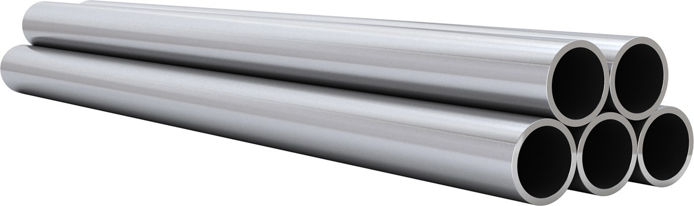
Most fuel designs employ some type of cladding
The primary focus of the cladding is to separate the fuel from the coolant
Fuel contains dangerous fission products
Avoids corrosion of the fuel by the coolant
Keeps the fuel together, not blocking coolant flow
The cladding should be thin and have a high thermal conductivity, so it doesn’t trap any of the heat produced by the fuel

Slide 26
Fuel/Cladding Gap
Fuel swells during reactor operation and the cladding creeps down around the fuel
To avoid/limit both chemical and mechanical interaction, the pellet radius is smaller that the inner radius of the cladding
In LWRs, the gap is filled with gas, significantly impacting the heat transport
In metal fuels, the gap is filled with liquid sodium, so there is little impact on the heat transport

Slide 27
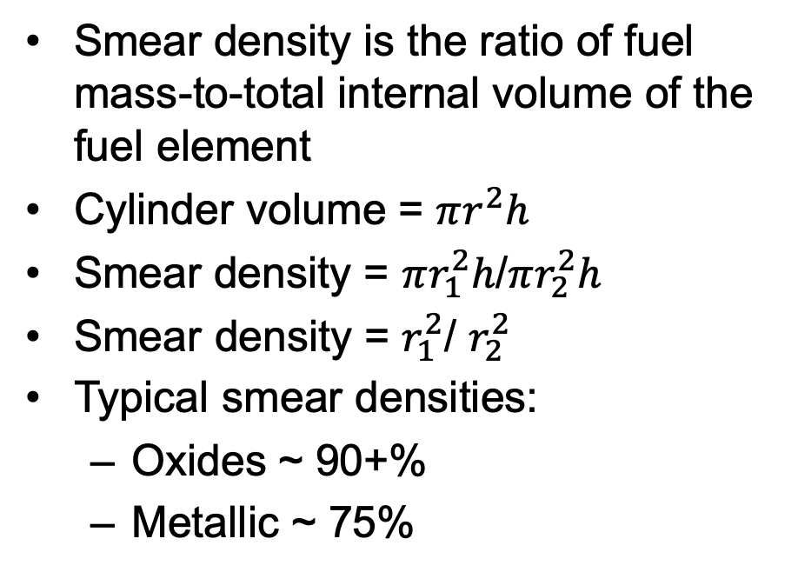
Smear Density
Smear density is the ratio of fuel mass-to-total internal volume of the fuel element
Cylinder volume = $πr^{2}h$
Smear density = $πr_{1}^{2}h$/$πr_{2}^{2}h$
Smear density = $r_{1}^{2}$/ $r_{2}^{2}$
Typical smear densities:
Oxides ~ 90+%
Metallic ~ 75%
r1
H
r2

Slide 28
Cladding material selection
Cladding must be compatible with the coolant, reasonably compatible with the fuel, have good thermal conductivity and reasonable radiation resistance
Zirconium is used because of its
Low neutron cross section
Corrosion resistance in 300 C water
Resistance to void swelling
Adequate mechanical properties
Good thermal conductivity
Affordable cost
Available in large quantities
Other cladding materials in use include
Stainless steel
Silicon Carbide
Ferritic-Martensitic steels like Fe-Cr and Fe-Cr-Al
Oxide dispersion strengthened (ODS) ferritic steels

Slide 29
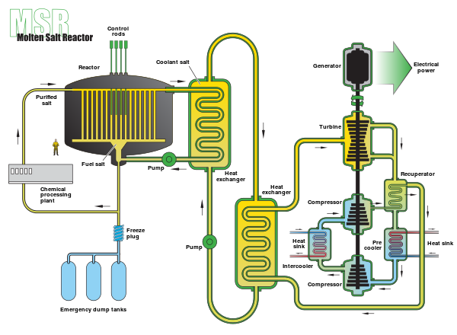
Molten Salt Reactors w/o cladding
Some MSRs plan to utilize liquid UCl3 as the fuel, flowing continuously through the core
Secondary loop comprised of coolant salt, such as LiCl-KCl

Slide 30
Summary
All reactors have basic requirements they must meet
An approach to remove the heat from the fuel
A method to convert heat to electricity
An approach to prevent radioactive products from leaving the fuel
A method to cycle the fuel
A method to remove used fuel and add new fuel
Containment in case something goes very wrong
LWRs have a certain way of meeting these requirements, but there are other options
Various fuel geometries have been used
Cladding is often required between the fuel and the coolant

